Slide 1
Agent Architectures

Slide 2
Objectives
Agent definition
Environment definition
Performance measure
Rationality
Agent Architectures
Simple Reflex agent
Model-based Reflex agent
Goal-based agent
minimax
Utility-based agent
Learning agent
Example: flocking

Slide 3
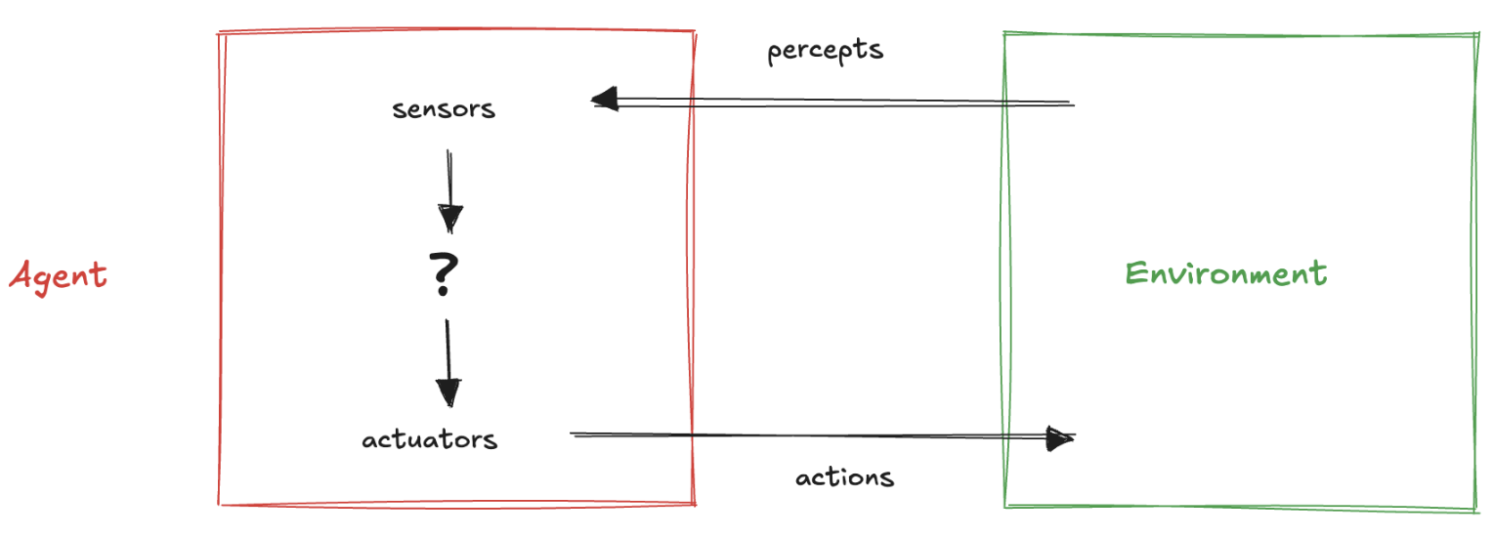
Agent vs Environment
Agent: perceives environment through sensors and interacts with it using actuators
human agent: senses (vision and hearing) as sensors and limbs or speech as actuators
robotic agent: cameras and range finders for perception and motors for action
software agent: processes data from files, networks, or user inputs and interacts by writing files, transmitting data, or displaying information
Environment: entire universe or the part that influences the agent perceptions and is altered by its actions

Slide 4
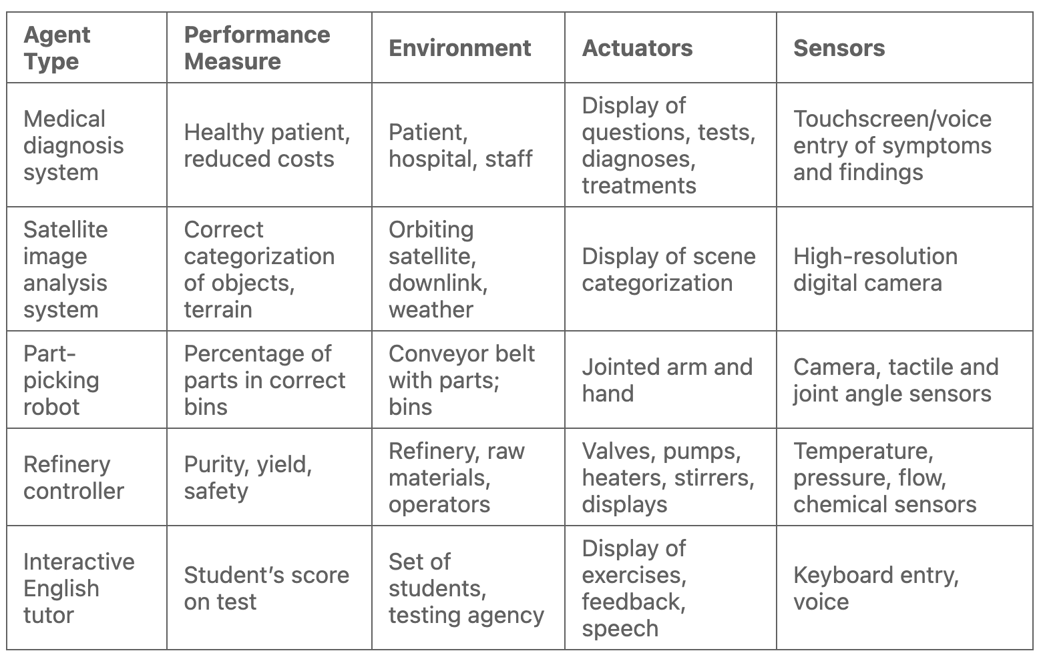
PEAS
Performance measure, environment, actuators and sensors

Slide 5

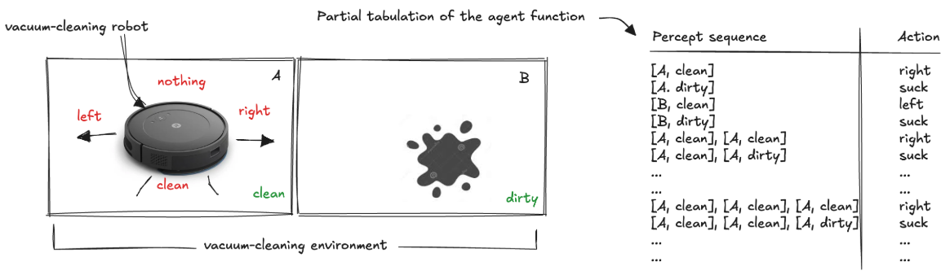
Agent (1)
Agent actions determined by its built-in knowledge and the entire sequence of percepts it has observed so far
Agent behaviour is defined by an agent function: maps percept sequences to actions
Example: a vacuum-cleaning robot:
Agent program: implements the agent function
agent function: abstract mathematical mapping
agent program: concrete implementation running on a physical system

Slide 6
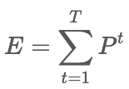
Agent (2)
Agent program skeleton:
takes current percept as input → returns an action to actuators.
Agent program vs. Agent function
Program: only current percept (environment provides nothing more)
Function: depend on entire percept history → agent must remember
The Lookup Table approach
For every percept sequence → an action
Problem: the table size explodes
P = number of possible percepts
T = agent lifetime (number of percepts)
E = number of entries
Examples:
Automated driving (single camera, 1 hour): 70 MB per second (30 fps, 1080×720 pixels, 24-bit color) → 10^600.000.000.000 entries
Chess: requires at least 10^150 entries
⚠️ Lookup tables are physically impossible to store, design, or learn
RL challenge: design efficient agent functions
Example:
“If current square is dirty → clean; else → move to other square”

Slide 7
Environment (1)
The problem to which the agent is the solution
its properties determine how the agent program must be designed
Observability
Fully observable: sensors give complete info → no need for internal state
Partially observable: limited/noisy sensors → agent must track hidden info
vacuum with only local dirt sensor
Agents
Single-agent: only one agent influences outcomes
Multi-agent: multiple agents interact
Competitive (chess, poker): opponents reduce your performance → randomization may be useful
Cooperative (taxi-driving): shared goals → communication is rational
Determinism
Deterministic: next state fully determined by current state + action
Non-deterministic: outcomes uncertain
Stochastic: outcome probabilities known
Partial observability can make a deterministic world appear non-deterministic
Dynamics
Static: unchanged while agent deliberates (crossword)
Dynamic: changes while agent thinks (driving)
Semi-dynamic: environment static but performance evolves (chess with a clock)

Slide 8
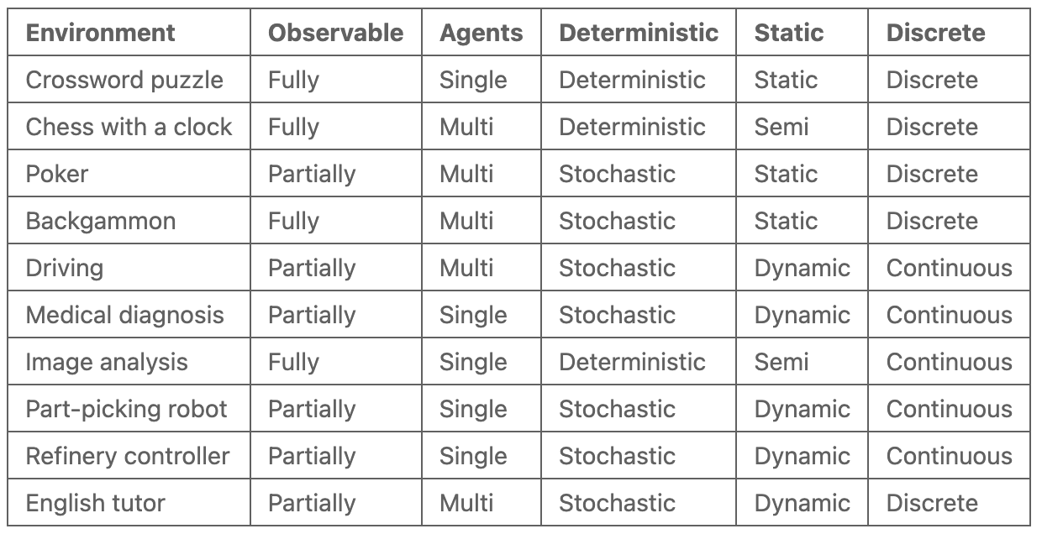
Environment (2)
Discrete vs Continuous
Discrete: limited states, percepts, actions (chess)
Continuous: smooth changes in state/time/actions (driving)
Known vs Unknown (agent’s knowledge of rules/outcomes)
Known: agent knows outcomes/probabilities (solitaire)
Unknown: must learn rules (new video game)
Performance measure can also be unknown → agent learns from users/designers
The Hardest Case: partially observable, multi-agent, stochastic, dynamic, continuous
Autonomous driving combines all these difficulties

Slide 9
Performance measure
Defined by the designer (machines lack intrinsic desires)
Must reflect what we want, not how we think the agent should behave
rewarding only “cleaning actions” → vacuum agent may create dirt to clean
better: reward sustained cleanliness
Difficult to be designed
If performance measure ignores movement cost → oscillates uselessly
If movement is penalized → poor performance
Better design:
stay idle when sure the floor is clean
periodically check if recontamination is possible
Autonomy and Learning
Non-autonomous agent → relies only on pre-programmed knowledge
Autonomous agent →
gathers information (e.g., looks both ways before crossing)
learns from experience to improve over time
Example:
Fixed-pattern vacuum vs. predictive vacuum (anticipates dirt)
Predictive one is more rational across varied environments

Slide 10
Rationality
Rational agent → selects actions that maximize the expected performance measure
Factors Affecting Rationality
the performance measure defining success
the agent’s prior knowledge of the environment
the set of available actions
the percept sequence observed so far
Rationality ≠ Omniscience
Omniscience: knows the actual outcome of every action (impossible)
Rationality: chooses the best expected action with available information
Example:
crossing an empty street is rational, even if a rare accident occurs

Slide 11
Architectures
The architecture: processes percepts, runs the program, and issues actions
must be compatible with the program
if program says “walk” → architecture must have legs
Agent = Architecture + Program
Key question: How do we build an intelligent agent?
no single recipe → several design approaches
each type combines components in different ways to map percepts → actions
Types of Agent Programs
Simple Reflex Agents: action depends only on current percept
Model-Based Reflex Agents: maintain an internal state (a model of the world)
Goal-Based Agents: choose actions based on desired goals
Utility-Based Agents: use utility functions to trade off between goals and optimize outcomes

Slide 12
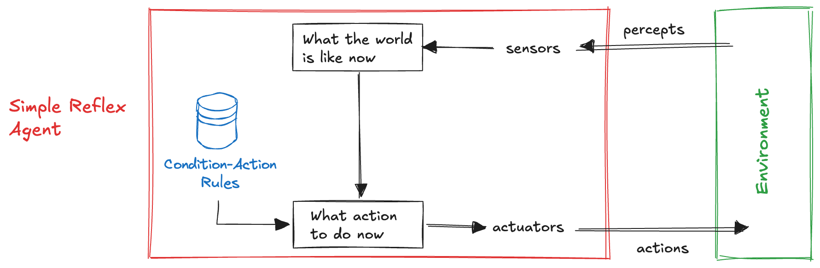
Simple Reflex Agent
Select actions only from the current percept, ignore percept history
much smaller than lookup tables, reduces complexity
effective for direct, immediate reactions
fail in partially observable environments → risk of infinite loops
Practice
Autonomous vehicle: brake when brake lights ahead are detected
Human reflexes: blink when object nears eye
Roomba (1st gen): random motion, turn when obstacle/edge detected
IFTTT (If This Then That): if rain is forecast → send umbrella reminder
👉 Simple reflex agents = fast & lightweight
⚠️ But limited: only effective when current percept alone is enough

Slide 13
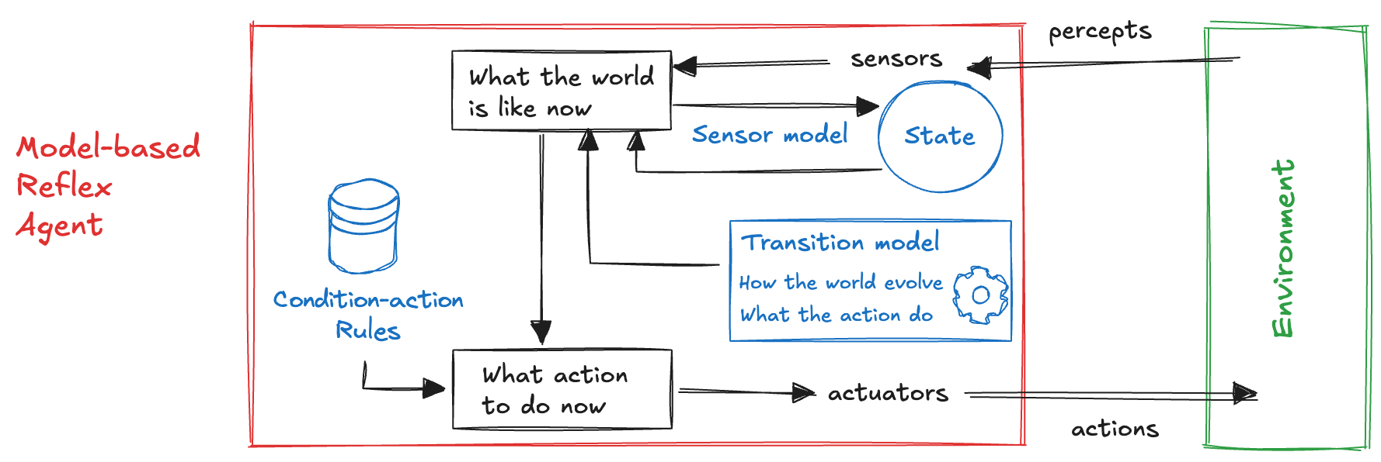
Model-based reflex agents (1)
Handle partial observability by maintaining an internal state, to capture unobserved aspects of the environment using percept history
Transition model → how the world changes
effects of actions (steering → turning)
external influences (rain → reduced visibility)
Sensor model → how states appear in sensor data
brake lights = red regions in camera feed
How It Works
update state = current percept + previous state + model
use updated state to select action via rules
exact state often uncertain, but decisions must be made anyway

Slide 14
Model-based reflex agents (2)
Vacuum Cleaner Example
tracks cleanliness of two locations
rules:
If dirty → suck
else → move to other location
if both clean → stop
Real-World Examples
Roomba 980: builds visual map for coverage & efficiency
Dyson 360 Eye: uses 360° camera to scan surroundings and navigate intelligently
👉 Model-based reflex agents = more powerful & flexible than simple reflex agents but require models of transitions + sensors.

Slide 15
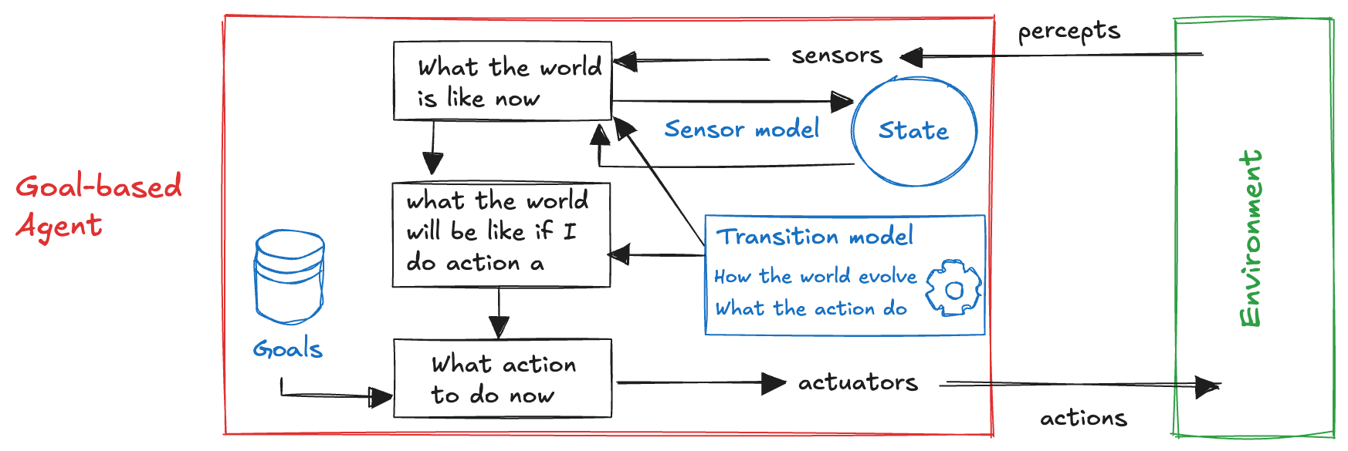
Goal-based agents (1)
Current state alone is not enough
at a road junction: left, right, or straight?
correct choice depends on the goal (destination)
Agent needs:
state description
goal information (desirable outcomes)
How They Work
combine model of the world + goal → select actions
if one action achieves goal → simple
if sequence required → need search & planning

Slide 16
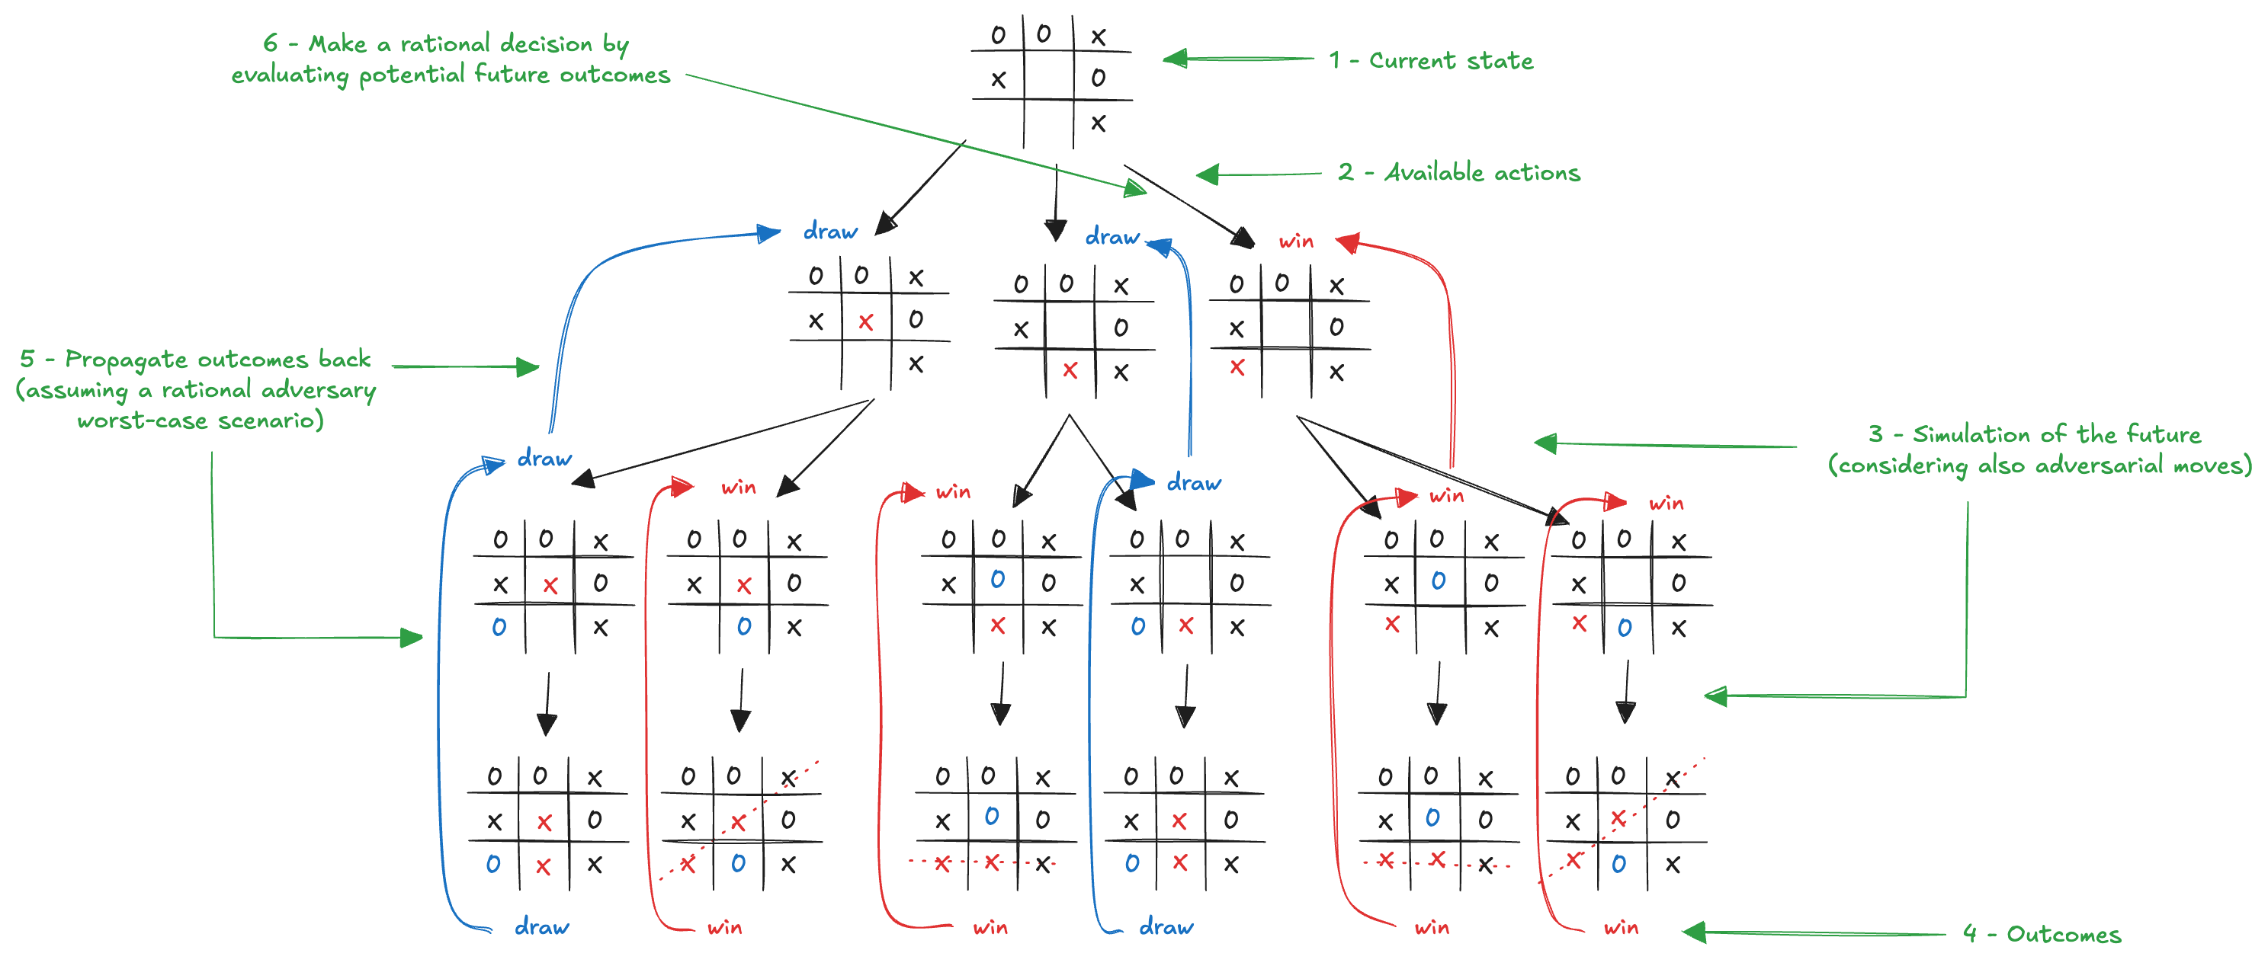
Goal-based agents (2)
Examples
driving: brake not just because lights are red, but to avoid collision
Tic-Tac-Toe: goal = win, use search algorithms (minimax) to explore move sequences and find optimal action
👉 Goal-based agents = adaptable, flexible, and future-oriented
⚠️ Require planning & search, which can be computationally expensive

Slide 17
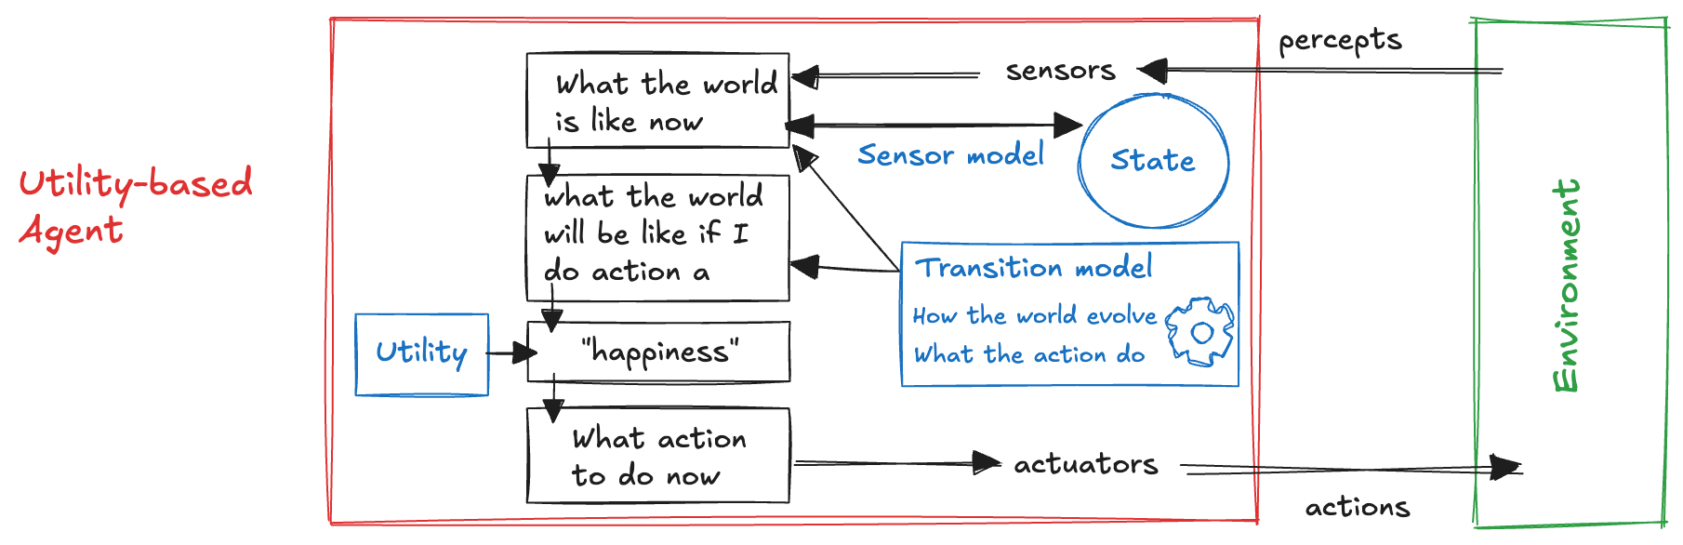
Utility-based agents
Problem with goals:
binary (success/failure)
many action sequences may achieve the goal
some are faster, safer, or more efficient
Utility = numerical measure of desirability of outcomes
extends goals into graded preferences
👉 Utility-based agents = more powerful and flexible than goal-based agents

Slide 18
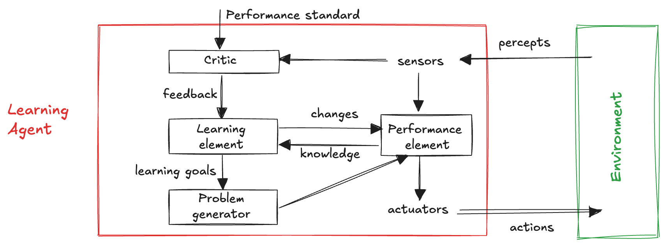
Learning agents
Any agent type (model-based, goal-based, utility-based) can learn & adapt
enables operation in unknown environments
Four Components:
performance element selects actions (the “agent” as studied so far)
learning element improves the agent’s behaviour over time
critic: provides feedback (reward/penalty)
problem generator suggests exploratory actions
👉 Learning agents = adaptive, autonomous, and continuously improving.

Slide 19
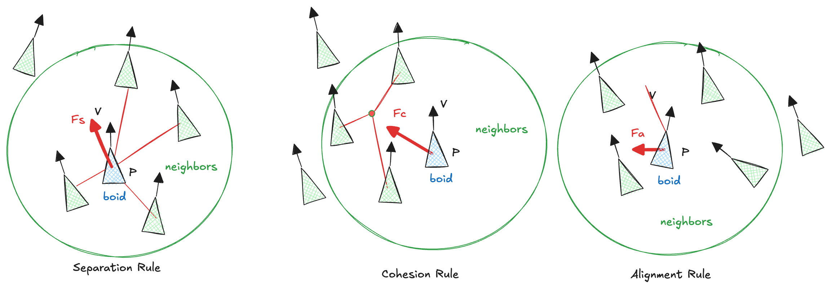
Example: flocking (1)
Simulates collective animal behaviour (birds, fish, ants)
Reynolds (SIGGRAPH, 1987): flocks, herds, and schools
Each agent = boid (bird-oid object)
local perception
agents consider neighbours within a limited radius
Complex group motion emerges from simple local rules
Separation: avoid crowding neighbours → prevents collisions
Cohesion: move toward the average position of neighbours → stay together
Alignment: match the average heading of neighbours → move in same direction

Slide 20

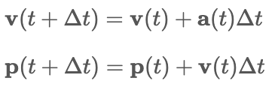
Example: flocking (2)
Each rule generates a force (acceleration request):
Forces combine to determine agent’s motion at each step:
Euler integration rule:
Collective flocking = emergent behaviour from simple rules
👉 Reynolds showed how distributed, local rules can create coherent global patterns, inspiring AI, robotics, and computer graphics

